Slide 1
Introductory Analysis and Visualization in R
Week 2: Working with data frames in the tidyverse
June 19, 2020
Jennine Dawicki McKenna
Senior Research Investigator, Black Lab

Slide 2
Overview
Brief review
Tips for organizing projects
Importing datasets into R (readr package)
Using “verbs” to manipulate data frames (dplyr package)
Piping (magrittr package)
Tidy data (tidyr package)
More ways to get help and additional resources
[Take home script- handling missing numbers]
Try it out: Take one of your data sets and play around with it!
Start with code that works and modify it.
Notes:
A few comments on organizing projects first

Slide 3
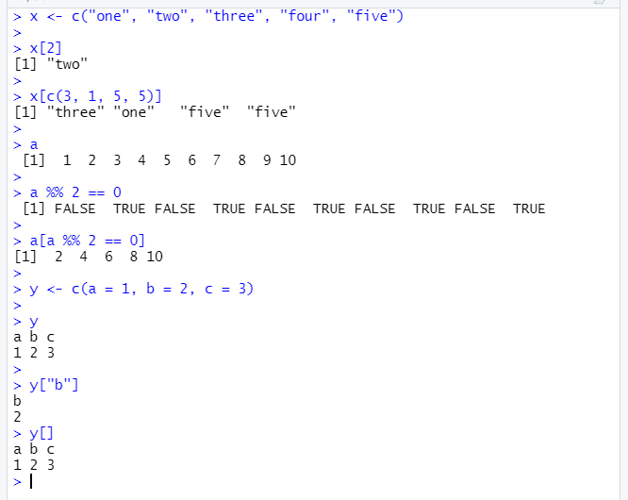
Review
Left-hand side
Variable name
x <- 2
Right-hand side
Value
< -
Assignment operator in R
Assignment
Data structures
R is vectorized!
Atomic vectors (homogenous) – logical, character, double, integer
Data frames – columns are homogenous, rows can be heterogenous
Subsetting
By position or name
Using logical operators
Access columns of data frame with $
Function calls
function_name(arg1, arg2 = val2)

Slide 4
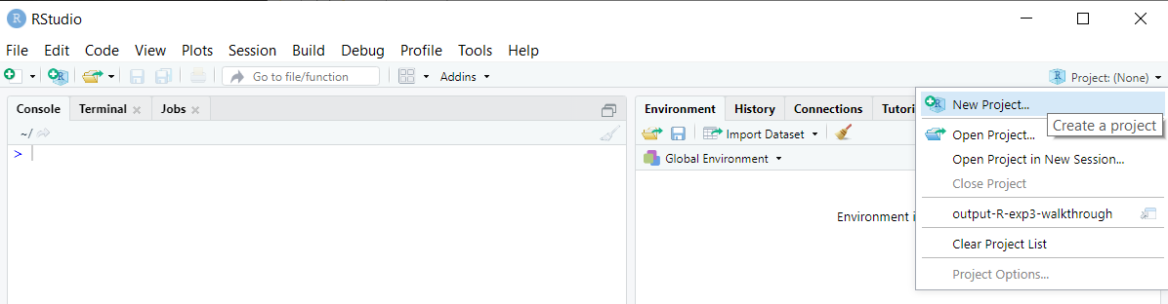
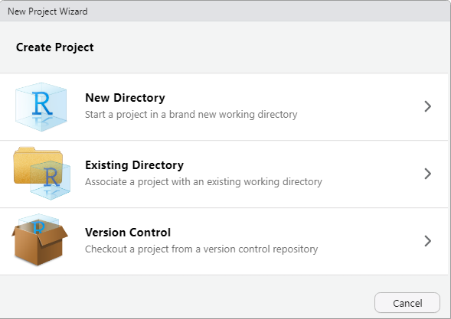
RStudio has built-in features to help you manage and share projects
Creating a Project in RStudio
RStudio projects allow you to keep all the files associated with a project together (input data, R scripts, results, figures).

Slide 5
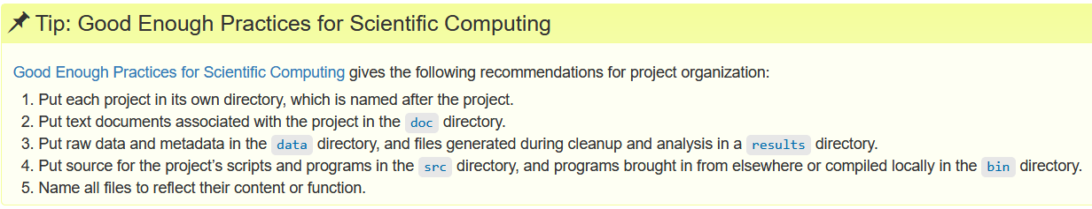
Quick note on project management and reproducibility
Best practices
Treat data as “read only”
Treat generated output as disposable
For tips on project organization, check out:
http://swcarpentry.github.io/r-novice-gapminder/02-project-intro/index.html
Notes:
There’s no one right way, but here are some tips and best practices.

Slide 6
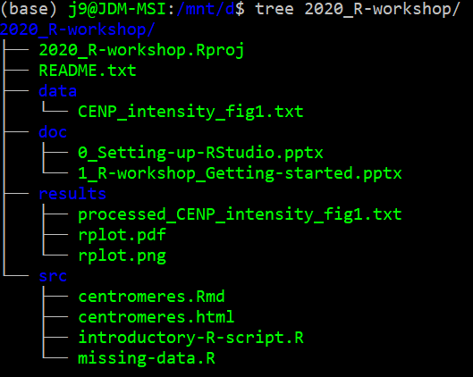
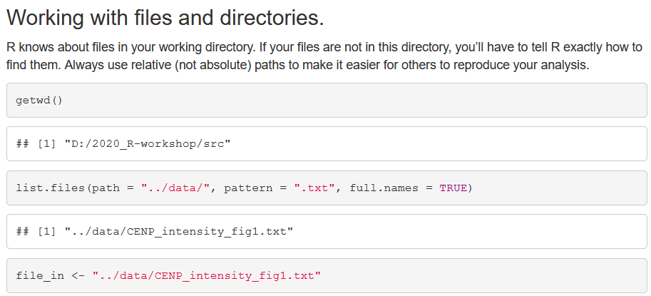
Where does R look for and save files? Working directory
“path” in quotes,
use relative paths- why?
. current dir
.. up one dir
/ demarcates a dir
Some useful functions
getwd()
setwd()
dir()
list.files()
Notes:
We’d like to get our data into R. How do we let R know where to find it?
Try it out. Open Rstudio. Everyone’s wd will be different.
What do you think list.files() is doing here? How might you find out?

Slide 7
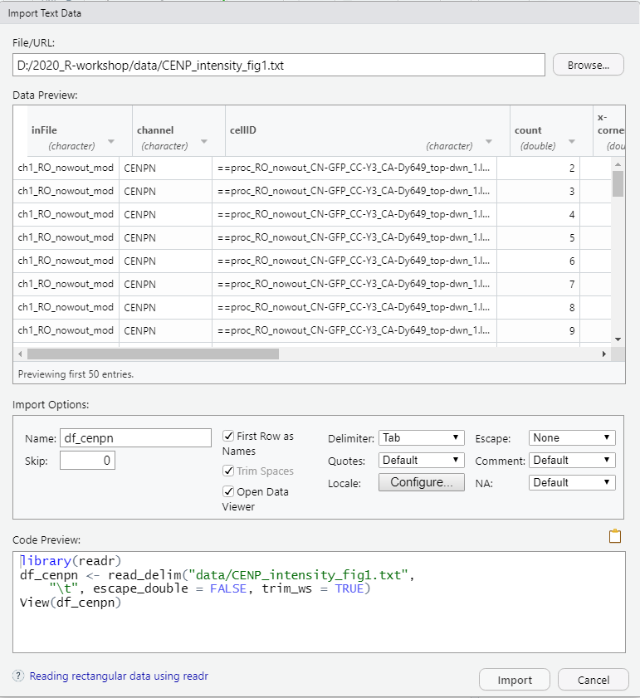
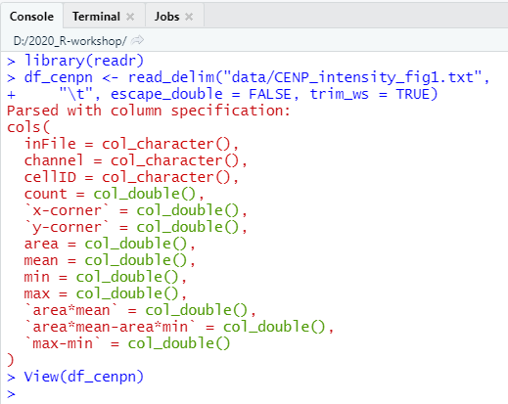
Importing datasets into R: readr package 1. GUI
File > Import Dataset > From text (readr)
R will display the code behind the import in the Code Preview and the Console.

Slide 8
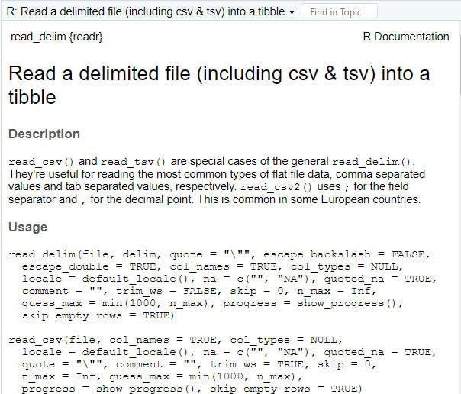
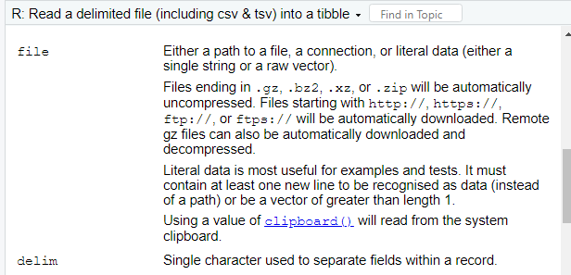
2. Now programmatically for reproducibility
required args
Note: \ is used to “escape” special characters
“\”” quote
“\t” tab
“\n” new line
Other args optional with default values
Notes:
read_delim is part of the readr package within the tidyverse. Remember how to pull up documentation
read_delim function, required arguments

Slide 9
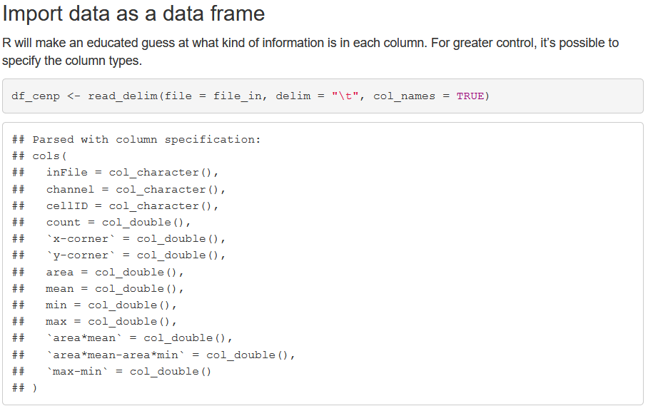
Import and assignment statement
See also the more specialized
read_csv
read_tsv
And from the readxl package:
read_xlsx
Note: tibbles are designed to work with flat files.
If you have a specialized dataset, check out Bioconductor for available packages:
https://www.bioconductor.org/packages/devel/bioc/vignettes/proDA/inst/doc/data-import.html

Slide 10
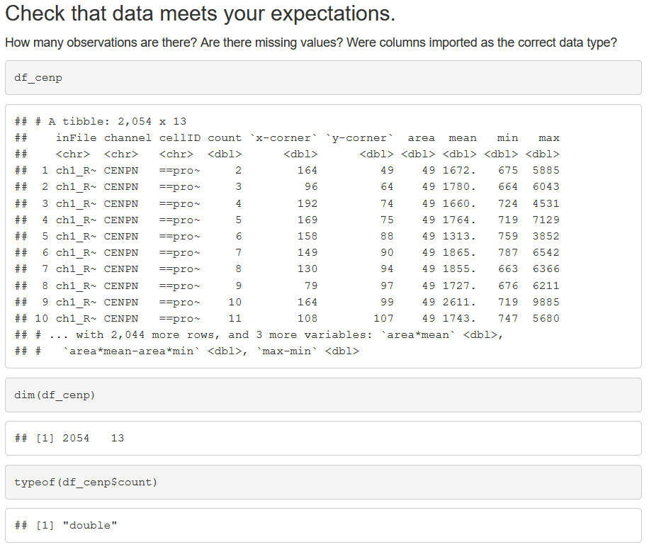
Now we’ve imported our data as a data frame (“tibble”)
What are some different ways we can explore our data frame?
Structure?
View the data?
We might also want to
create new variables (background subtraction, log transform, take a ratio)
create summaries
make the data a little easier to work with

Slide 11
Five key dplyr functions for data manipulation
filter() pick observations by their value
arrange() reorder rows
select() pick variables by their names
mutate() create new variables with functions of existing variables
summarize() collapse many values down to a single summary
group_by() works with all five functions above and changes their scope
How the “verbs” work:
The first argument is a data frame.
Subsequent arguments describe what to do with the data frame (using variable names without quotes).
Produces a new data frame: data frame in, data frame out.
https://r4ds.had.co.nz/transform.html

Slide 12
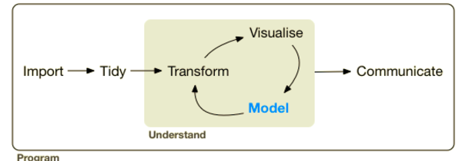
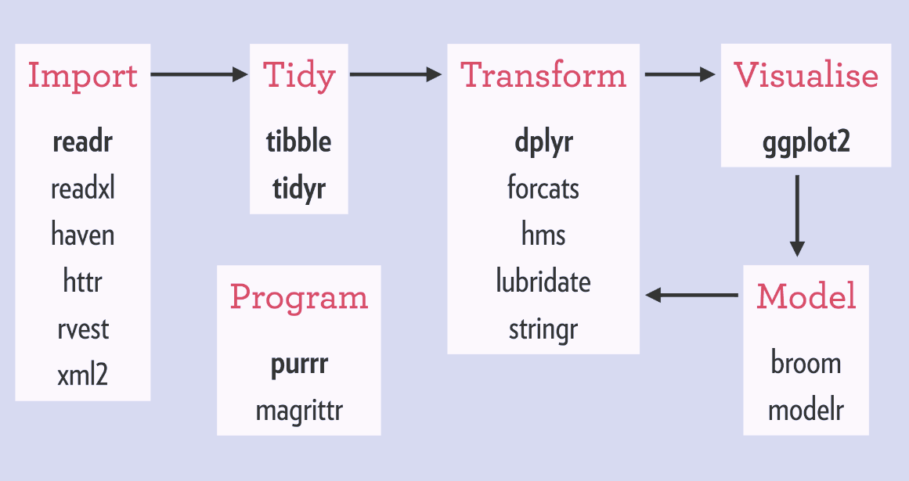
Philosophy of the tidyverse
coherent – designed to work together
consistency – apply what you already know
coverage – support throughout analysis workflow
parsimony – minimum set of functions
https://rviews.rstudio.com/2017/06/08/what-is-the-tidyverse/
Notes:
It might not seem so revolutionary, but for me

Slide 13
Walk through introductory-dplyr.R script alongside ppt

Slide 14
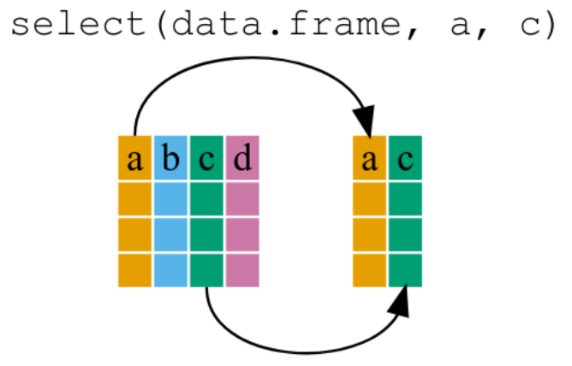
select() pick variables by their names (columns)
http://swcarpentry.github.io/r-novice-gapminder/13-dplyr/index.html

Slide 15
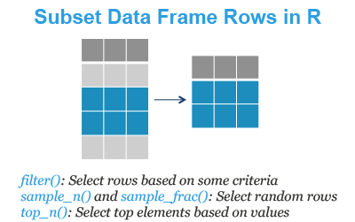
filter() pick observations by their value (rows)
https://www.datanovia.com/en/lessons/subset-data-frame-rows-in-r/

Slide 16
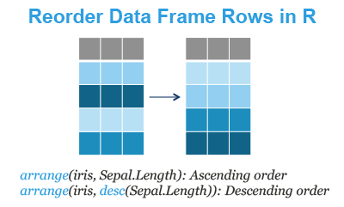
arrange() reorder rows
https://www.datanovia.com/en/lessons/reorder-data-frame-rows-in-r/

Slide 17

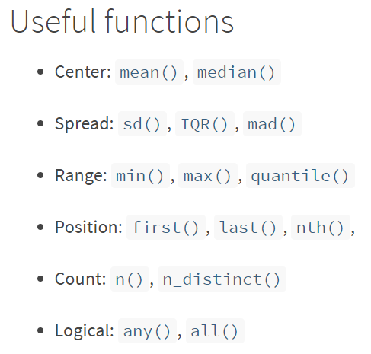
summarize() collapse many values down to a single summary
creates a new data frame
https://dplyr.tidyverse.org/reference/summarise.html#useful-functions

Slide 18
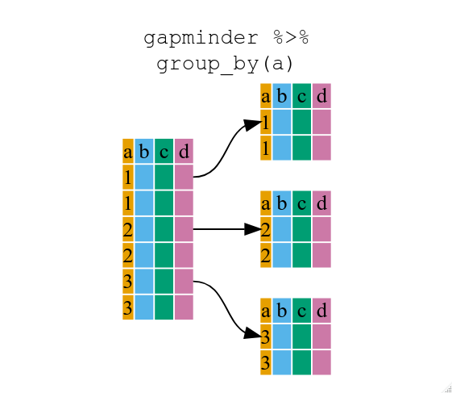
group_by() works with all five functions and changes their scope
https://swcarpentry.github.io/r-novice-gapminder/13-dplyr/

Slide 19
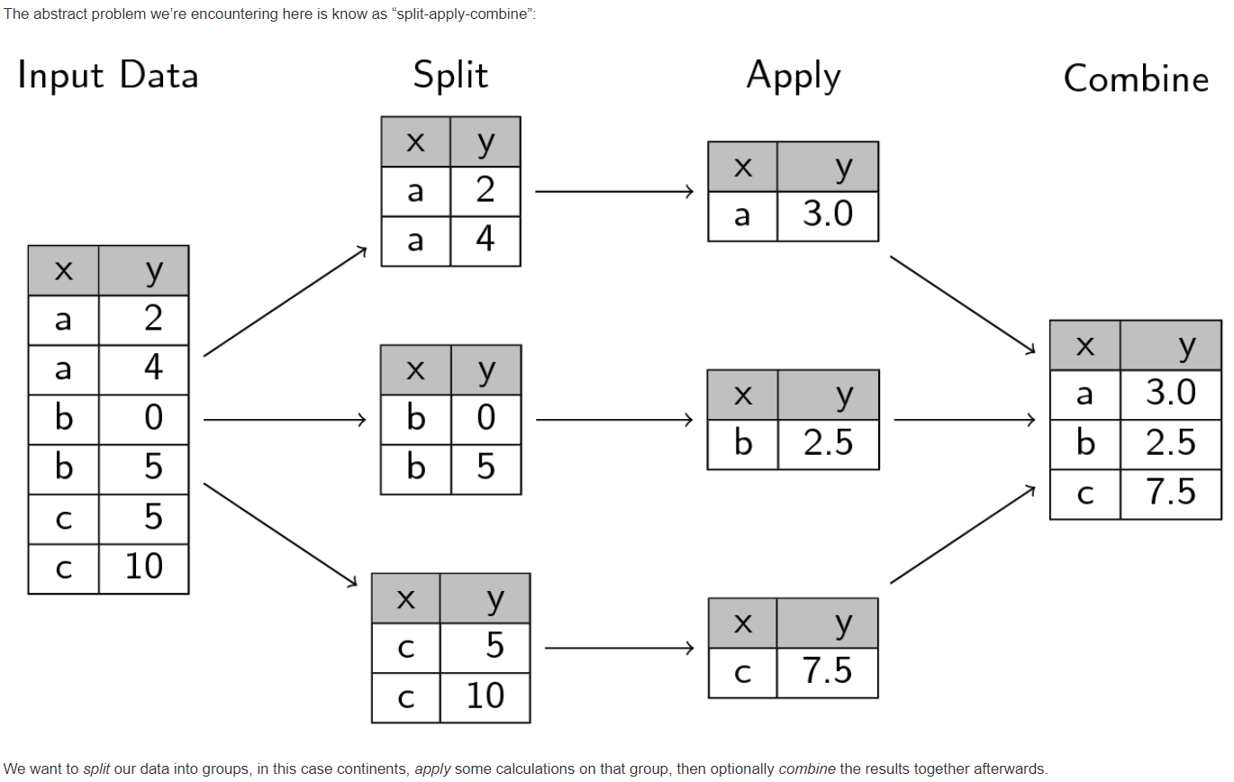
The split-apply-combine paradigm
http://swcarpentry.github.io/r-novice-gapminder/12-plyr/index.html
https://vita.had.co.nz/papers/plyr.html

Slide 20
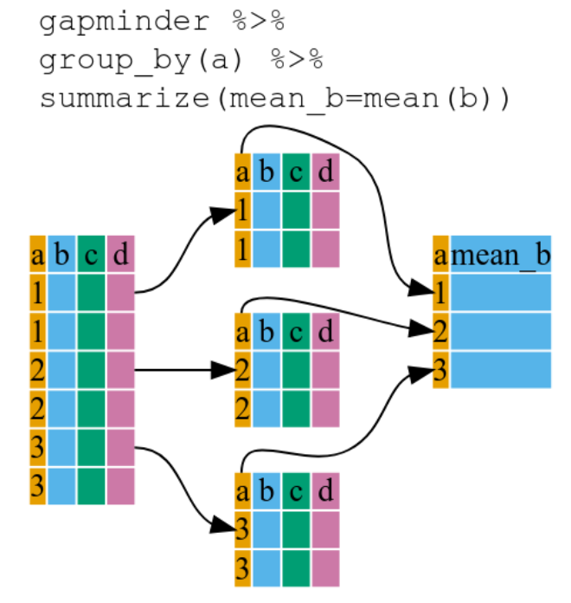
dplyr: group_by() combined with summarize()
http://swcarpentry.github.io/r-novice-gapminder/13-dplyr/index.html

Slide 21
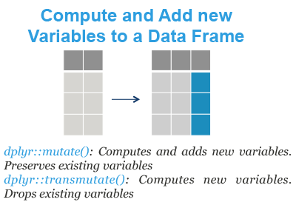
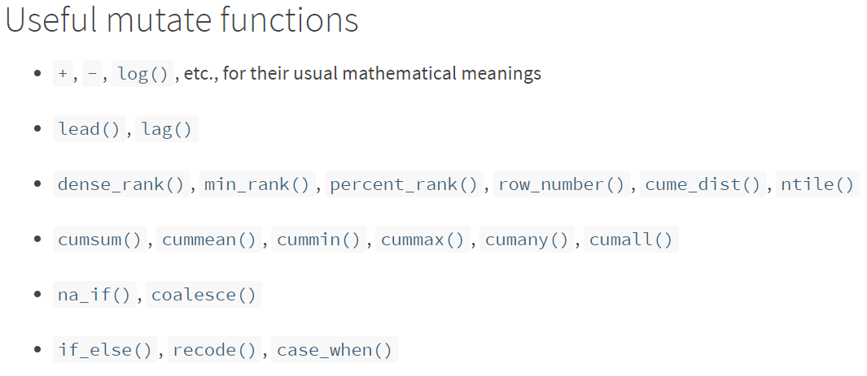
mutate() create new variables that are functions of existing variables
https://dplyr.tidyverse.org/reference/mutate.html
https://www.datanovia.com/en/lessons/compute-and-add-new-variables-to-a-data-frame-in-r/

Slide 22
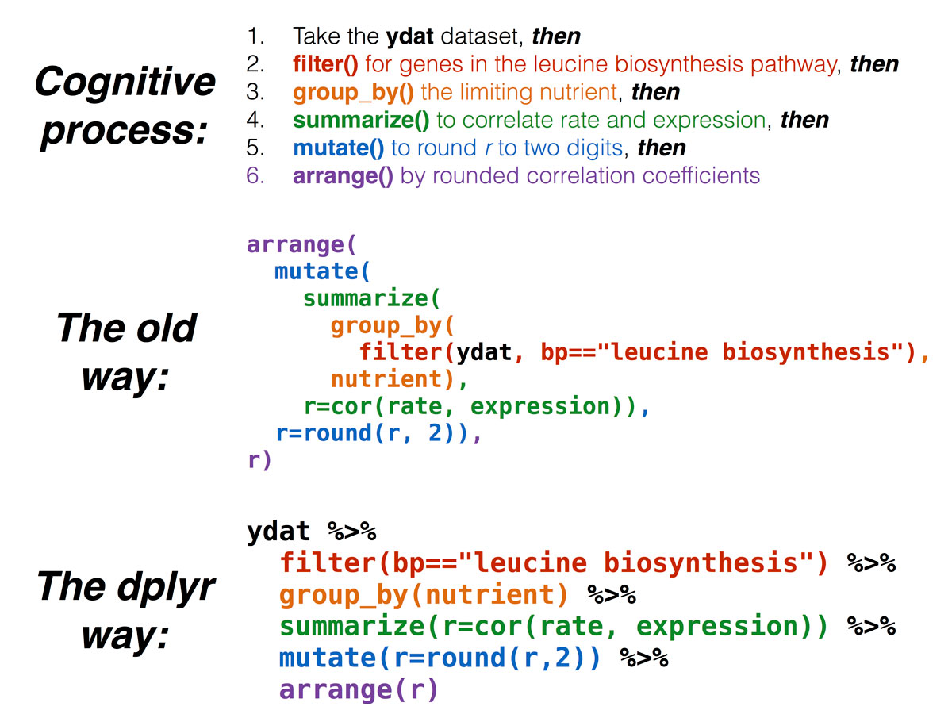
magrittr introduces the pipe “%>%” operator
Avoids intermediate variables
Avoids nested functions
Output of one step is the input of the next
Note- data frame is omitted from the function call
https://bioconnector.github.io/workshops/r-dplyr-yeast.html#the_pipe:_%%

Slide 23
A note on tibbles and non-syntactic names
Non-syntactic names are those that do not follow R’s rules for variable names
Unlike older data.frames in R, tibbles will not rename non-syntactic variables (using tibbles is encouraged)
Surround non-syntactic variable names with backticks, ` `

Slide 24
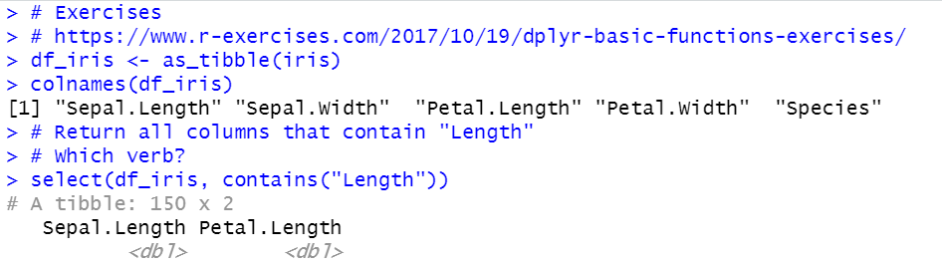
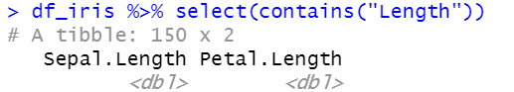
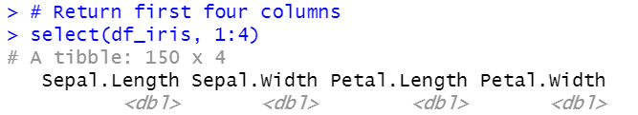
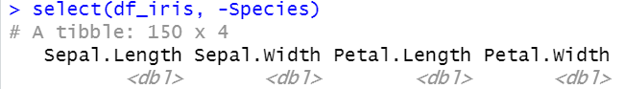
Try it out

Slide 25
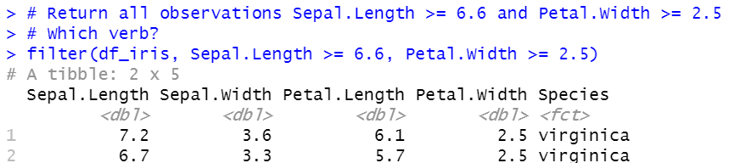
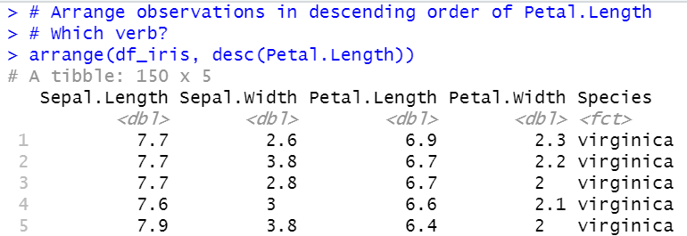
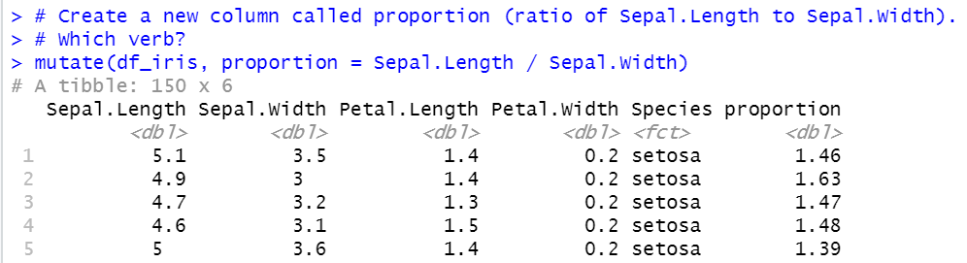
Try it out

Slide 26
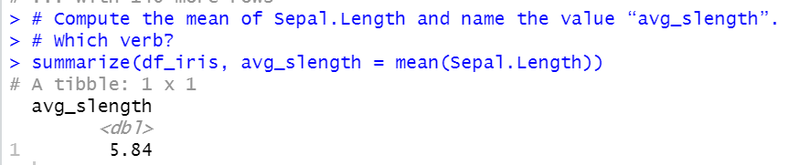
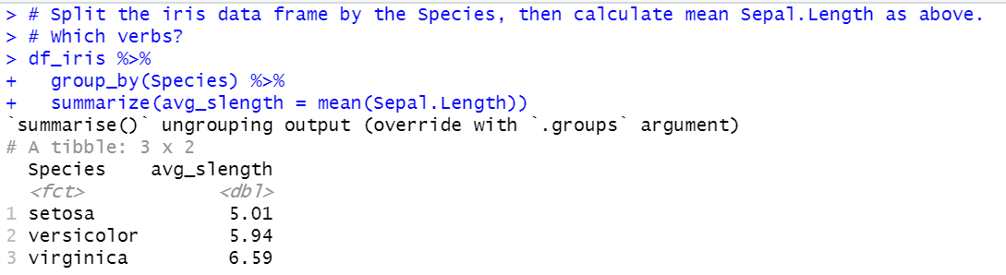
Try it out

Slide 27
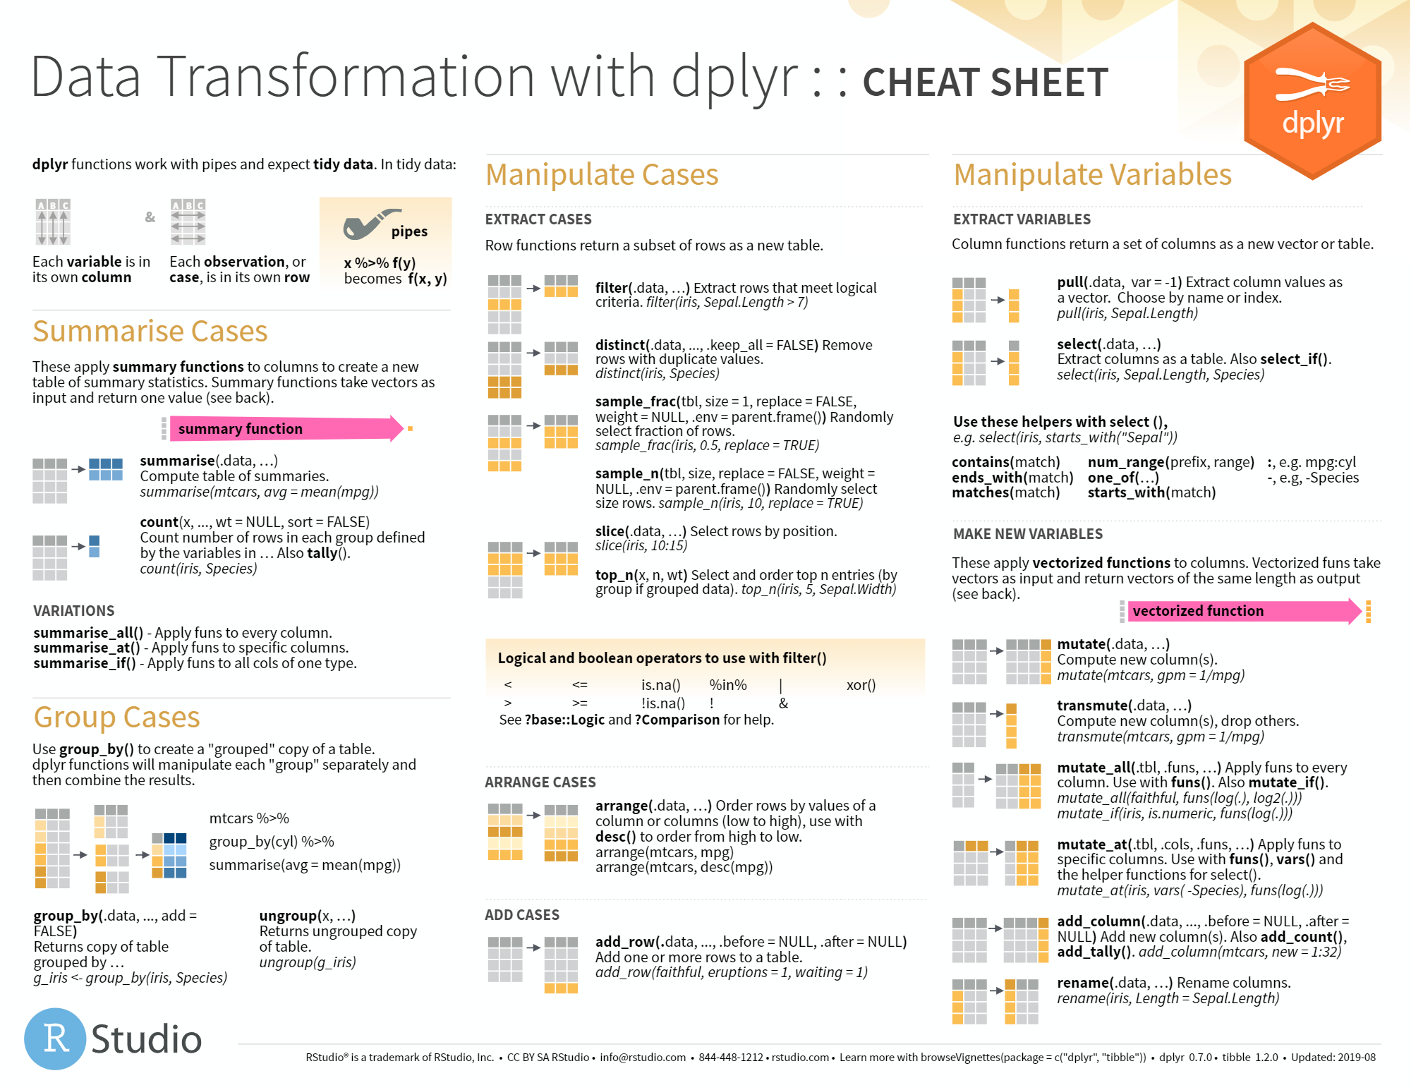
Check out the documentation: https://dplyr.tidyverse.org/
https://github.com/rstudio/cheatsheets/blob/master/data-transformation.pdf

Slide 28
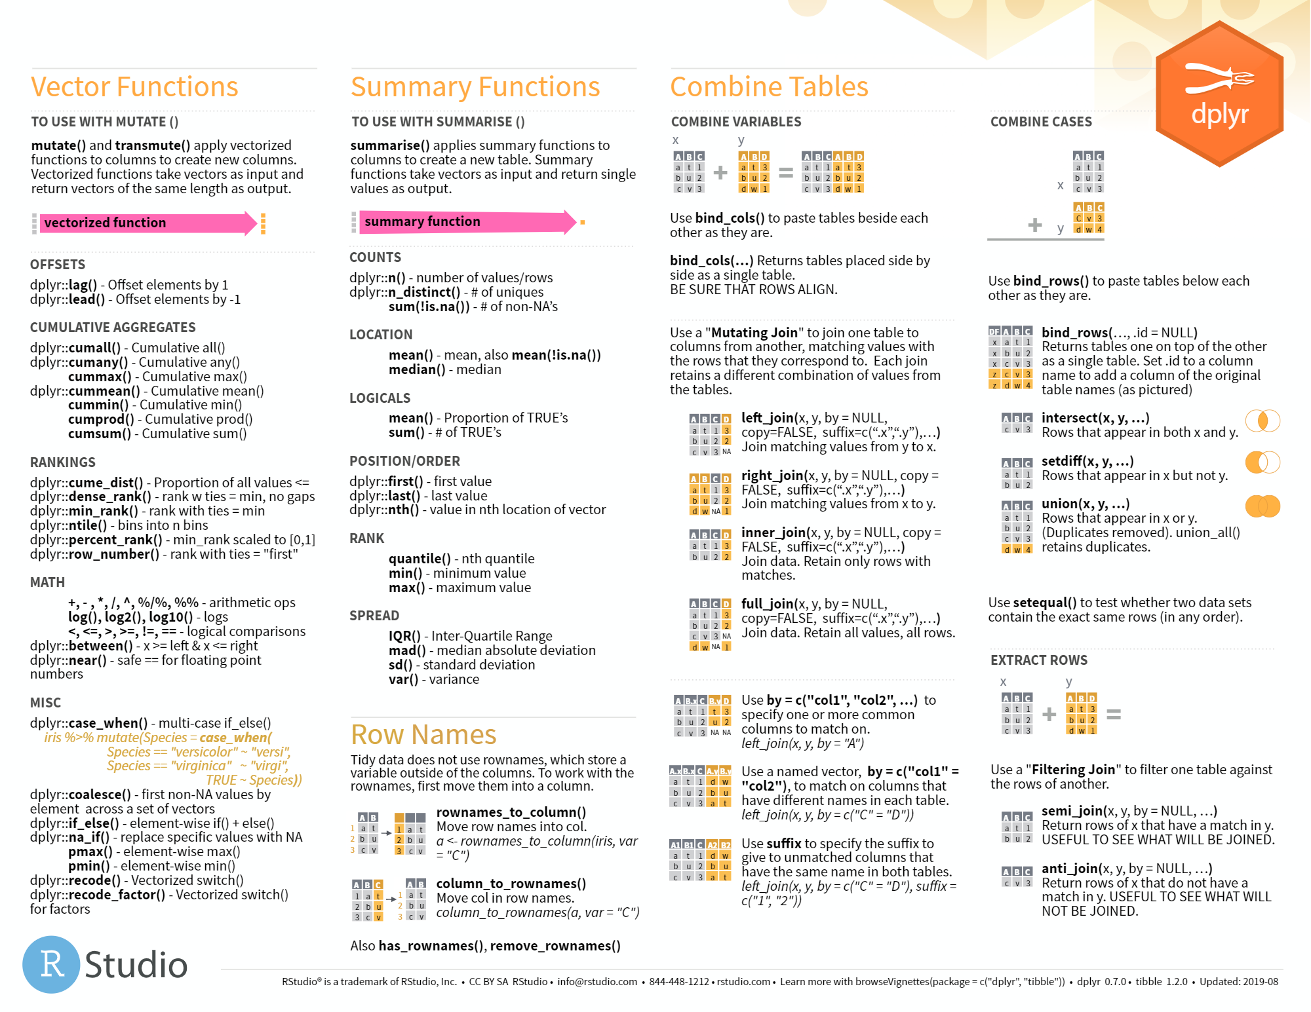
https://github.com/rstudio/cheatsheets/blob/master/data-transformation.pdf

Slide 29
The goal: reproducibility
The data isn’t always the way we want it:
May want to extract relevant information from a string
May need to perform background subtraction
Extraneous columns not in preferred order
Dataset might not be “tidy”, i.e. in a format best-suited for R’s vectorization
For a data set of this size, it’s completely reasonable to preprocess in Excel.
However, it will be harder for others to reproduce and for you to scale up.
But don’t let this be a stumbling block. You have to start somewhere.

Slide 30
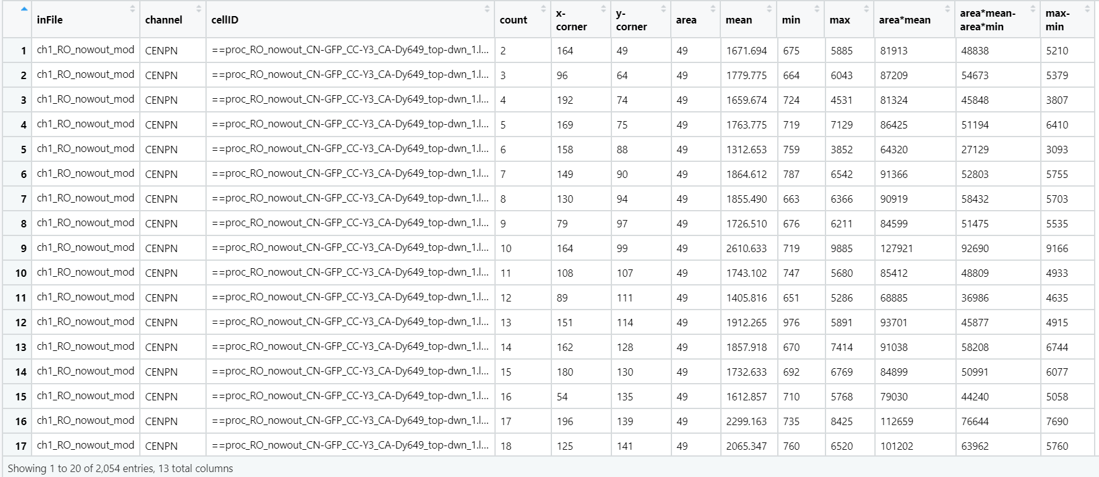
Back to the original example
Might not always have results of calculations
Create new variable from string
Could be considered not “tidy”-
variable of interest is not channel.
Don’t need some variables

Slide 31
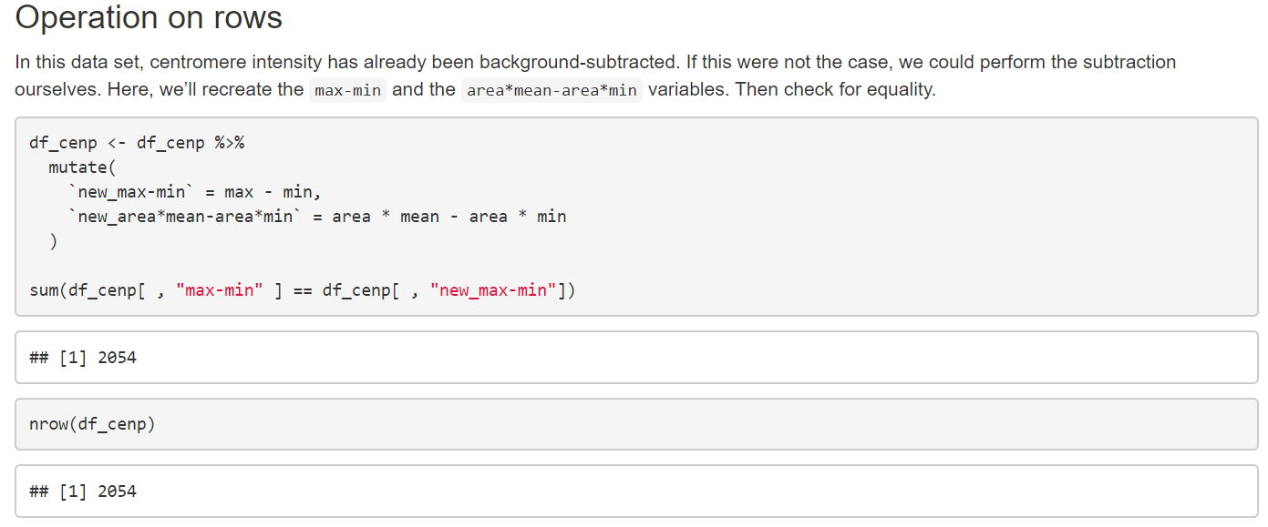
mutate()

Slide 32
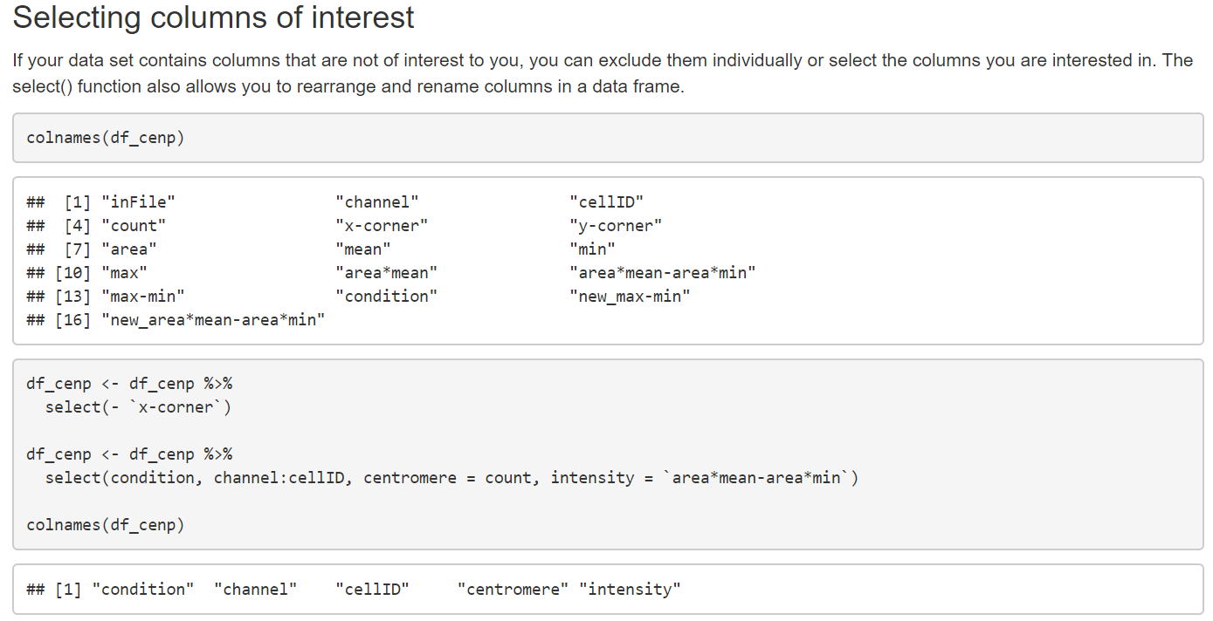
select()

Slide 33

“Tidy” data
Rules for tidy datasets:
Each variable must have its own column.
Each observation must have its own row.
Each value must have its own cell.
https://r4ds.had.co.nz/tidy-data.html

Slide 34
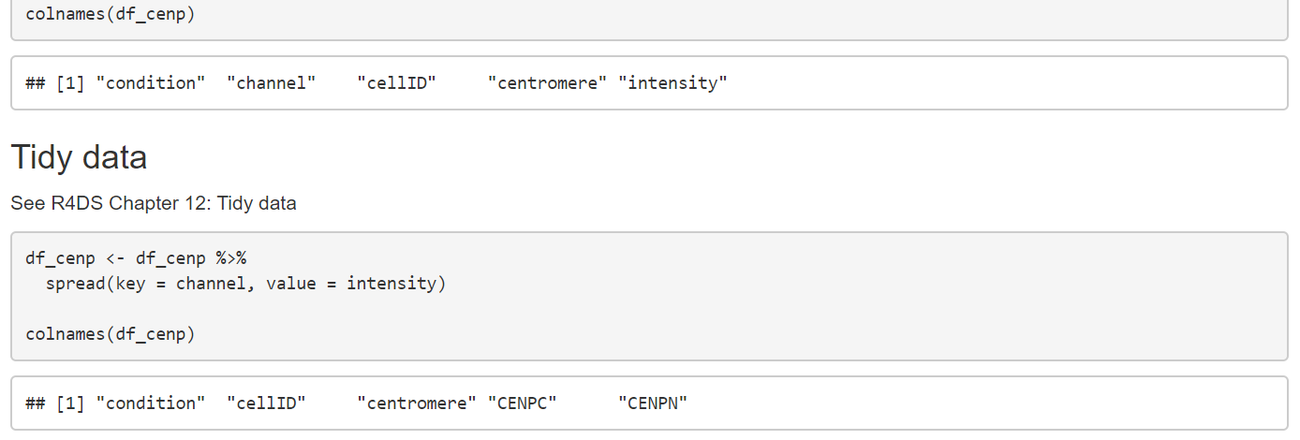
You can work around “untidy” data, but often it leads to more complicated code
CENP-N cell_A 1 intensity
CENP-C cell_A 1 intensity
Single observation spread over 2 rows,
2 variables share a single column
cell_A 1 CC_int CN_int
With each variable in its own column, it’s more intuitive to compute summary statistics or take a ratio of intensities, for example.

Slide 35
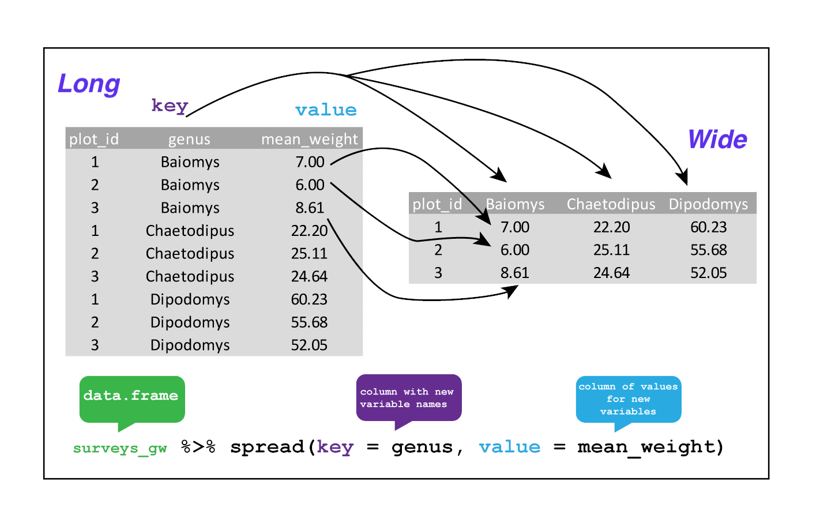
Reshaping data frames with spread()
arguments
the data frame (here, piped in)
the key column variable whose values will become new column names.
the value column variable whose values will fill the new column variables.
https://datacarpentry.org/R-ecology-lesson/03-dplyr.html#reshaping_with_gather_and_spread

Slide 36
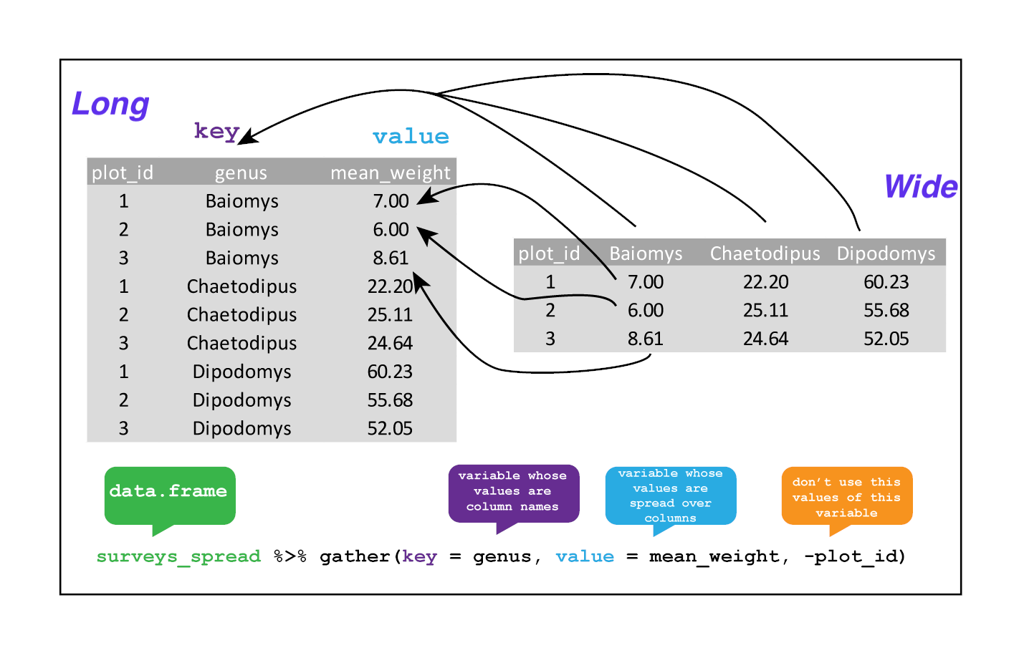
Reshaping data frames with gather()
arguments
the data frame (here, piped in)
the key column variable we wish to create from column names.
the values column variable we wish to create and fill with values associated with the key.
the names of the columns we use to fill the key variable (or to drop).
https://datacarpentry.org/R-ecology-lesson/03-dplyr.html#reshaping_with_gather_and_spread

Slide 37
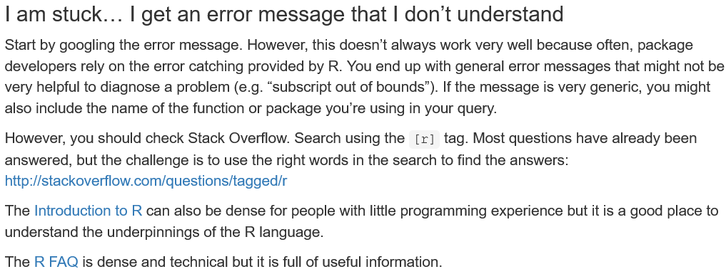
More places to find help
https://datacarpentry.org/R-ecology-lesson/00-before-we-start.html

Slide 38
Other resources
Check out Bioconductor for mass spec and high throughput-seq resources!
https://www.bioconductor.org/packages/release/bioc/
CRAN is a repository for other R resources and packages:
https://cran.r-project.org/

Slide 39
Work through R script on missing data

Slide 40
Next week
Were you able to import one of your own datasets? Did you try dplyr?
Creating visualizations in ggplot2
Iteration and flow control
Writing your own functions

